Slide 1
Quantitative Data Analysis:
A Companion for Accounting and Information Systems Research
Teaching Materials
Created by Willem Mertens, Amedeo Pugliese & Jan Recker

Slide 2
Copyright Notice
© Copyright 2017 W. Mertens, A. Pugliese & J. Recker. All Rights Reserved.

Slide 3

What these materials are about
Offering a guide through the essential steps required in quantitative data analysis
Introduction
Comparing Differences Across Groups
Assessing (Innocuous) Relationships
Models with Latent Concepts and Multiple Relationships: Structural Equation Modeling
Nested Data and Multilevel Models: Hierarchical Linear Modeling
Analyzing Longitudinal and Panel Data
Causality: Endogeneity Biases and Possible Remedies
How to Start Analyzing, Test Assumptions and Deal with that Pesky p-Value
Keeping Track and Staying Sane

Slide 4
Part 4:
Structural Equation Modeling

Slide 5
Recap: Which statistical approach for which question?
When should you use…
Descriptive statistics
Regression models?
Analysis of variance models?
Time-series models?
Structural equation models?

Slide 6
Structural Equation Modelling
A so-called second generation data analysis method
  First generation data analysis methods include techniques such as regression, (multivariate) analysis of (co-)variance (ANOVA).
  They are characterized by their shared limitation of being able to analyse only one layer of linkages between independent and dependent variables at a time.
  2nd generation methods allow for the simultaneous analysis of multiple independent and dependent variables
encourages confirmatory rather than exploratory analysis.

Slide 7
When do we use SEM?
Complex research models:
  Multiple associations between multiple independent and multiple dependent variables
  Usually also mediating and/or moderating variables present
  Latent concepts: Multi-dimensional constructs with several underlying dimensions
  Satisfaction, usefulness, attitude etc.
  Constructs that have multiple measures
  Often measured with perceptual (self-report) data
Often: survey research but also in experiments and others

Slide 8
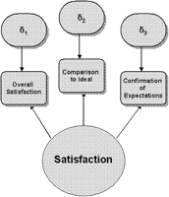
Latent constructs
abstractions about a phenomenon (e.g. usefulness, time, satisfaction, enjoyment) that are latent in that they relate to a real thing but do not have a tangible existence:
  Thus they cannot be measured directly
have indicators associated with them:
  Measures are our approximations to latent constructs
  – our empirical indicators that allow us to ‘grasp’
  the latent construct.
  1+ measure required per construct dimension
  (also called substratum)
  Typically multiple items because most constructs
  are indeed complex concepts that have
  multiple domains of meaning.

Slide 9
Components of a Structural Equation Model

Slide 10
A Simple Example

Slide 11
The corresponding construct table
PU | PEOU | ITU
PU1 | PEOU1 | ITU1
PU2 | PEOU2 | ITU2
PU3 | PEOU3 | ITU3
… | … | …
… | … | …

Slide 12
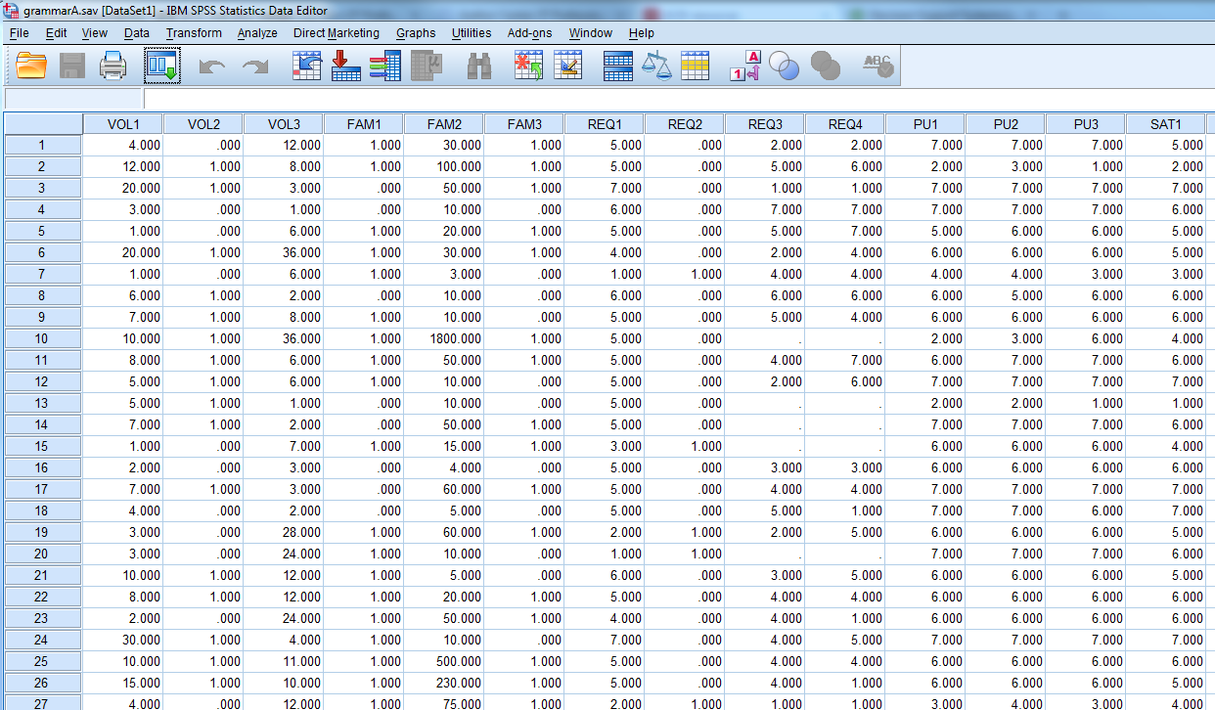
A Simple Example: the corresponding data

Slide 13

SEM Overview
Four phases of analysis
  (Descriptive statistics)
  Measurement model estimation
  Structural model estimation
  Mediation/Moderation/supplementary analyses

Slide 14
Descriptive Statistics
e.g., assessment of non-response error
Chi-square test of early versus late survey respondents
Demographic variable | p-value
Type of organisation | .206
Size of organisation | .436
Size of modelling team | .305
Country of origin | .100
Years of experience in process modelling overall | .346
Months of experience in process modelling with BPMN | .639
Number of BPMN models created | .345
Type of training | .784
Use of modelling tool | .060
Use of modelling guidelines | .311
Use of BPMN constructs | .542

Slide 15
Structural Model Estimation: 5-stage process
Model specification
  Specification of an a-priori research model with theoretical constructs and hypothesized relationships between them.
Model identification
  Estimation of unknown parameters (such as factor loadings, path coefficients or explained variance) based on observed correlations or covariances.
Model estimation
  Finding of one set of model parameters that best fits the data.
Model fit testing
  Assessment of how well a model fits the data.
Model re-specification
  Improvement of either model parsimony or fit.

Slide 16
Measurement Model Estimation

Slide 17
Measurement Model Estimation
Examines whether the model of what we measure fits the properties of the data we collected
Often confused with confirmatory factor analysis.
The actual test criteria (for reflective models) is Goodness of Fit.
Goodness of fit statistics for the measurement model (GFI = 0.91, NFI = 0.97, NNFI = 0.98, CFI = 0.98, SRMR = 0.05, RMSEA = 0.06, χ2 = 436.71, df = 155) suggest good fit of the measurement model to the data set, considering the approximate benchmarks suggested by Im and Grover (2004).

Slide 18
Measurement Model Estimation for Reflective Measures
Assessment of the reliability and validity of the scales used.
Tests
  Uni-dimensionality
    A construct is uni-dimensional if its constituent items represent one underlying trait
  Reliability and composite reliability
    Reliability is defined as the degree to which scale items are free from error and, therefore, yield consistent results.
  Convergent validity
    Convergent validity tests if measures that should be related are in fact related.
  Discriminant validity
    Discriminant validity refers to the degree to which items of different constructs are unique from each other.

Slide 19
Measurement Model Estimation
Validation via standard set of indices (e.g., Fornell and Larcker, 1981)
  Uni-dimensionality:
    Cronbach’s Alpha (α) > 0.7
  Reliability:
    Cronbach’s Alpha (α) > 0.8
    Composite reliability (p_{c}) > 0.5
  Convergent validity:
    Average variance extracted (AVE) > 0.5
    Indicator factor loadings (λ) > 0.6
    Indicator factor loadings significant at p < 0.05
    Composite reliability (p_{c}) > 0.8
  Discriminant validity:
    AVE should exceed the squared correlations between each of the constructs

Slide 20
Reporting Measurement Model Results
Scale item | Item mean | Item S.D. | Item loading | Sig.
PU1 | 6.01 | 1.058 | .798 | .000
PU2 | 5.90 | 1.060 | .803 | .000
PU3 | 5.48 | 1.598 | .774 | .000
SAT1 | 5.19 | 1.273 | .797 | .000
SAT2 | 5.09 | 1.304 | .806 | .000
SAT3 | 4.78 | 1.458 | .776 | .000
CON1 | 4.94 | 1.226 | .835 | .000
CON2 | 4.95 | 1.299 | .856 | .000
CON3 | 4.90 | 1.293 | .852 | .000
PEOU1 | 5.14 | 1.315 | .777 | .000
PEOU2 | 5.05 | 1.353 | .876 | .000
PEOU3 | 5.05 | 1.339 | .875 | .000
ItU1 | 6.00 | .977 | .820 | .000
ItU2 | 6.03 | .926 | .843 | .000
ItU3 | 5.60 | 1.329 | .712 | .000

Slide 21
Reporting Measurement Model Results
Construct Correlations
Scale Properties
 | PU | SAT | CON | PEOU | ItU
PU | 1.000
SAT | .621 | 1.000
CON | .535 | .607 | 1.000
PEOU | .464 | .467 | .604 | 1.000
ItU | .577 | .642 | .652 | .593 | 1.000
Construct | Mean | S.D. | Cronbach’s α | ρ_{c} | AVE
PU | 17.39 | 3.366 | .865 | .820 | .909
SAT | 15.06 | 3.792 | .932 | .872 | .940
CON | 14.78 | 3.660 | .956 | .914 | .959
PEOU | 15.24 | 3.684 | .908 | .850 | .922
ItU | 17.63 | 2.960 | .887 | .842 | .923

Slide 22
Model Fit
Fit index | Suggested value | TAM (EPC) | ECT (EPC) | Hybrid (EPC) |  | TAM (BPMN) | ECT (BPMN) | Hybrid (BPMN)
GFI | > 0.900 | 0.942 | 0.932 | 0.926 |  | 0.956 | 0.950 | 0.934
AGFI | > 0.900 | 0.933 | 0.913 | 0.901 |  | 0.918 | 0.920 | 0.902
NFI | > 0.900 | 0.956 | 0.932 | 0.915 |  | 0.982 | 0.986 | 0.982
NNFI | > 0.900 | 0.946 | 0.923 | 0.905 |  | 0.979 | 0.986 | 0.985
CFI | > 0.900 | 0.964 | 0.943 | 0.927 |  | 0.986 | 0.990 | 0.988
SRMR | < 0.050 | 0.0439 | 0.0489 | 0.0496 |  | 0.0466 | 0.0433 | 0.0471
RMSEA | < 0.080 | 0.0731 | 0.0742 | 0.0784 |  | 0.0831 | 0.0693 | 0.070
χ² (df, p) | - | 119.383 (24, 0.000) | 292.705 (49, 0.000) | 537.519 (81, 0.000) |  | 119.863 (24, 0.000) | 190.000 (49, 0.000) | 307.129 (81, 0.000)
R² for ItU | - | 0.310 | 0.151 | 0.355 |  | 0.317 | 0.269 | 0.396

Slide 23
Structural Model Estimation: Results Reporting

Slide 24
Let’s do it.
SEM Exercise based on
Recker, J. (2010): Explaining Usage of Process Modeling Grammars: Comparing Three Theoretical Models in the Study of Two Grammars. Information & Management, Vol. 47, No. 5-6, pp. 316-324
freely available from http://eprints.qut.edu.au/34162/

Slide 25
Our Research Model

Slide 26
SEM: Advanced matters: for Discussion
PLS versus LISREL (or AMOS)
Reflective vs formative models
Moderator analysis & mediation analysis
Missing data

Slide 27
1. PLS versus LISREL
Or: correlation- versus covariance-based SEM
What are current beliefs?
What are strengths?
What are weaknesses?

Slide 28
Reported Reasons for using PLS in Marketing:
non-normal data (50%), small sample size (46%), formative measures (33%), prediction = research objective (28%), complex models (13%), categorical variables (13%).
Average PLS sample size is 211 compared to 246 for CB-SEM. But 25% had less than 100 observations, and 9% did not meet recommended sample size criteria.
No studies report skewness or kurtosis.
42% reflective only; 6% formative only; 40% mixed; 12% no indication.

Slide 29
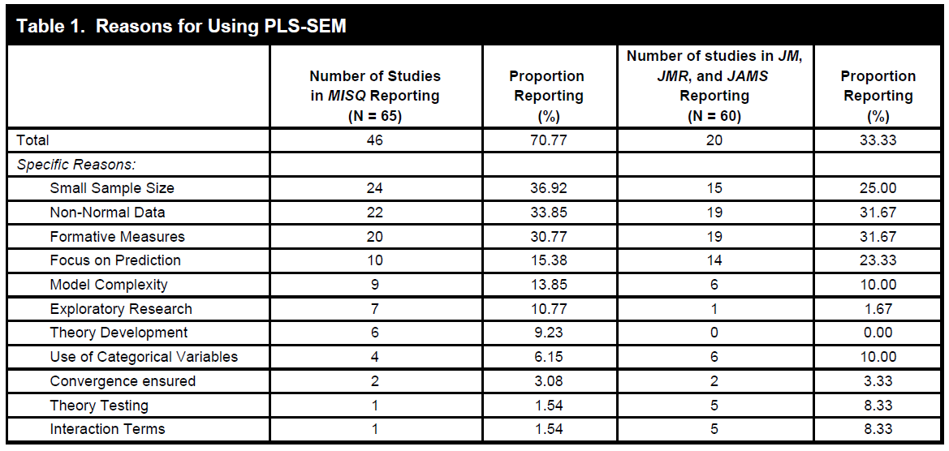
Reported Reasons for using PLS in IS:
  Ringle, C.M., Sarstedt, M., and Straub, D.W. "Editor's Comments: A Critical Look at the Use of PLS-SEM in MIS Quarterly," MIS Quarterly (36:1) 2012, pp iii-xiv.

Slide 30
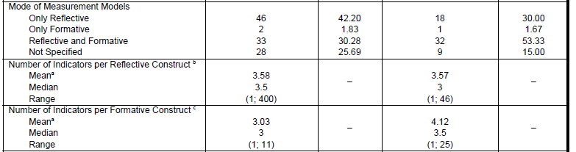
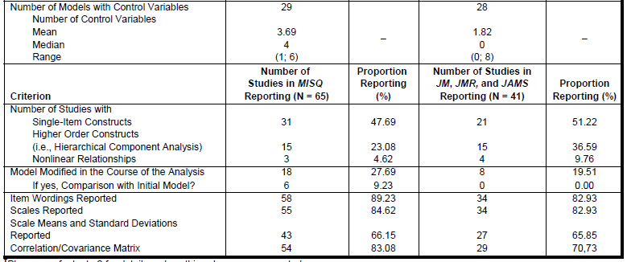
Reported PLS-SEM Model Types in IS:
  Ringle, C.M., Sarstedt, M., and Straub, D.W. "Editor's Comments: A Critical Look at the Use of PLS-SEM in MIS Quarterly," MIS Quarterly (36:1) 2012, pp iii-xiv.

Slide 31
Criteria | Variance-Based Modeling (e.g. SmartPLS, PLS Graph) | Covariance-Based Modeling (e.g. LISREL, AMOS, Mplus)
Objective | Prediction oriented | Parameter oriented
Distribution Assumptions | Non-parametric | Normal distribution (parametric)
Required sample size | Small (min. 30 – 100) | High (min. 100 – 800)
Model complexity | Large models OK | Large models problematic (50+ indicator variables)
Parameter Estimates | Potential Bias | Stable, if assumptions met
Indicators per construct | One – two OK Large number OK | Typically 3 – 4 minimum to meet identification requirements
Statistical tests for parameter estimates | Inference requires Jackknifing or Bootstrapping | Assumptions must be met
Measurement Model | Formative and Reflective indicators OK | Typically only Reflective indicators
Goodness-of-fit measures | None | Many

Slide 32
2. Formative vs reflective models
A construct could be measured reflectively or formatively.
Constructs are not necessarily (inherently) reflective or formative.

Slide 33
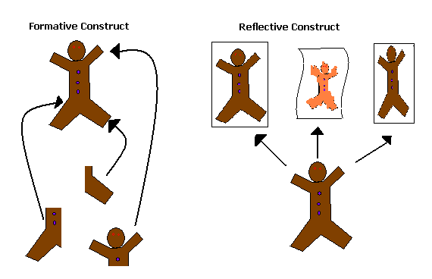
Formative vs reflective: Illustration
[Graphic courtesy of Robert Sainsbury, Mississippi State University]

Slide 34
Formative vs reflective: Example
Formative vs. Reflective
  Let’s take firm performance as an example.
  We can create a reflective scale that measures top managers’ views of how well the firm is performing.
    These scale items can be interchangeable, and in this way let the researcher assess the reliability of the measures in reflecting the construct.
  Or we can create a set of metrics for firm performance that measure disparate elements such as ROI, profitability, return on equity, market share, etc.
    These items are not interchangeable and, thus, are formative.

Slide 35
Some issues with formative measures
Reliability or internal consistency, as is traditionally measured, is not a factor in formative constructs. We want multicollinearity and unidimensionality in reflective constructs. Formative constructs are destabilized when this occurs. May need to eliminate items if they are redundant.
Decomposed models or indices can change the meaning of the theoretical relationship.
  Consider the theoretical implications (not just empirical).
Even if empirical results are weak, theoretically certain (formative) measures may be (very/not) important.
  Unclear how to handle.
  Debates for validation and measurement remain ongoing

Slide 36
3. Mediation vs Moderation

Slide 37
No Mediation

Slide 38
Full Mediation

Slide 39
Partial Mediation

Slide 40
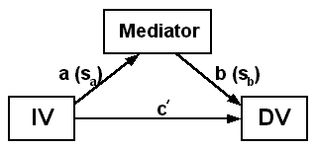
Sobel Mediation Test
Numbers needed
  a = raw (unstandardized)
  regression coefficient for the
  association between IV and mediator.
  sa = standard error of a.
  b = raw coefficient for the association between
  the mediator and the DV (when the IV is also a predictor of the DV).
  sb = standard error of b.
The Sobel test works well only in large samples. A better example includes bootstrapping of raw data:
Preacher, K. J., & Hayes, A. F. (2004). SPSS and SAS procedures for estimating indirect effects in simple Mediation models. Behavior Research Methods, Instruments, & Computers, 36, 717-731.
Sobel, M. E. (1982). Asymptotic intervals for indirect effects in structural equations models. In S. Leinhart (Ed.), Sociological methodology 1982 (pp.290-312). San Francisco: Jossey-Bass.

Slide 41
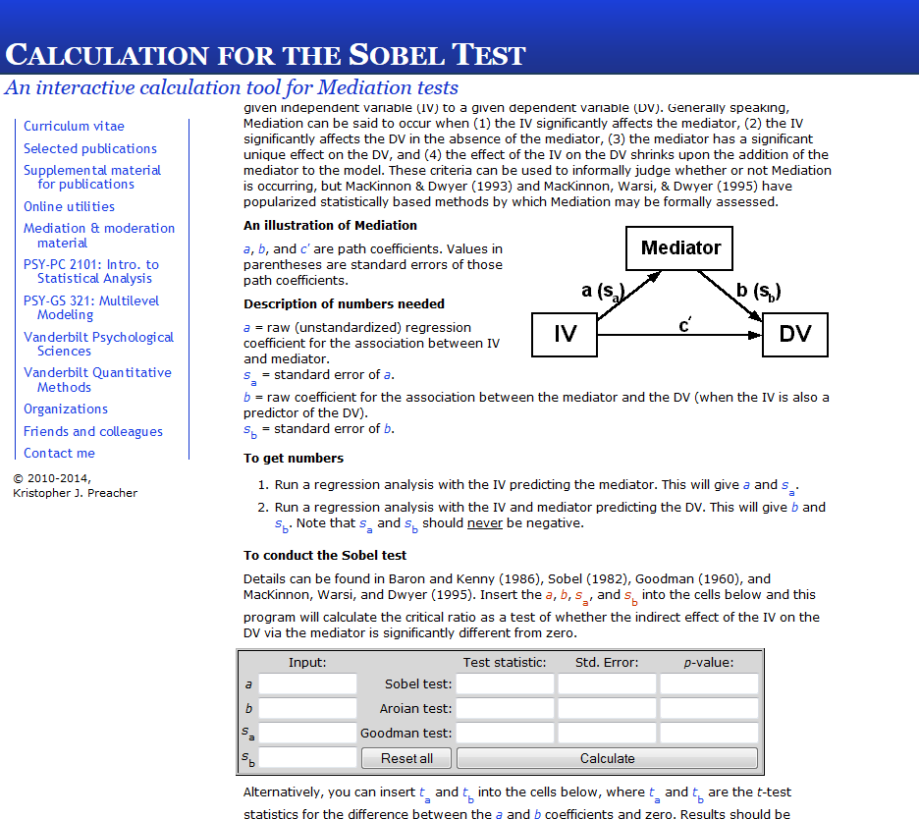
http://quantpsy.org/sobel/sobel.htm

Slide 42
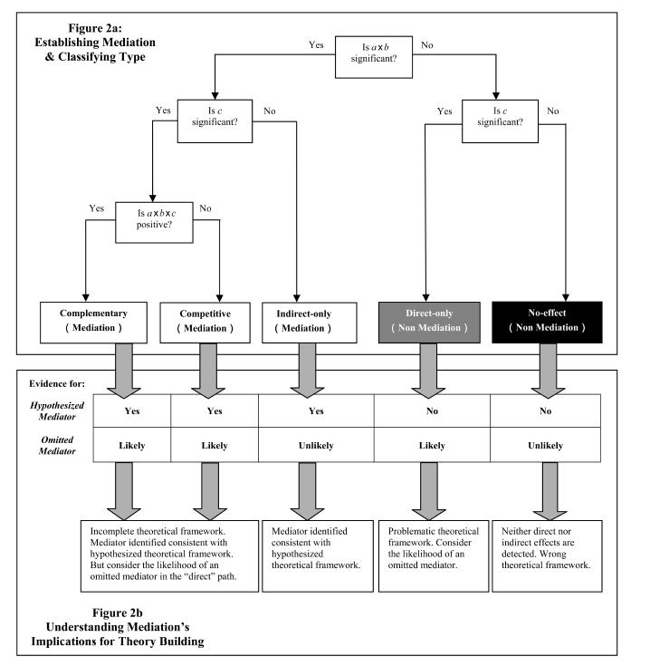
Procedure: Zhao et al. (2010)
Zhao, X., Lynch Jr., J.G., and Chen, Q. "Reconsidering Baron and Kenny: Myths and Truths about Mediation Analysis," The Journal of Consumer Research (37:2) 2010, pp 197-206.

Slide 43
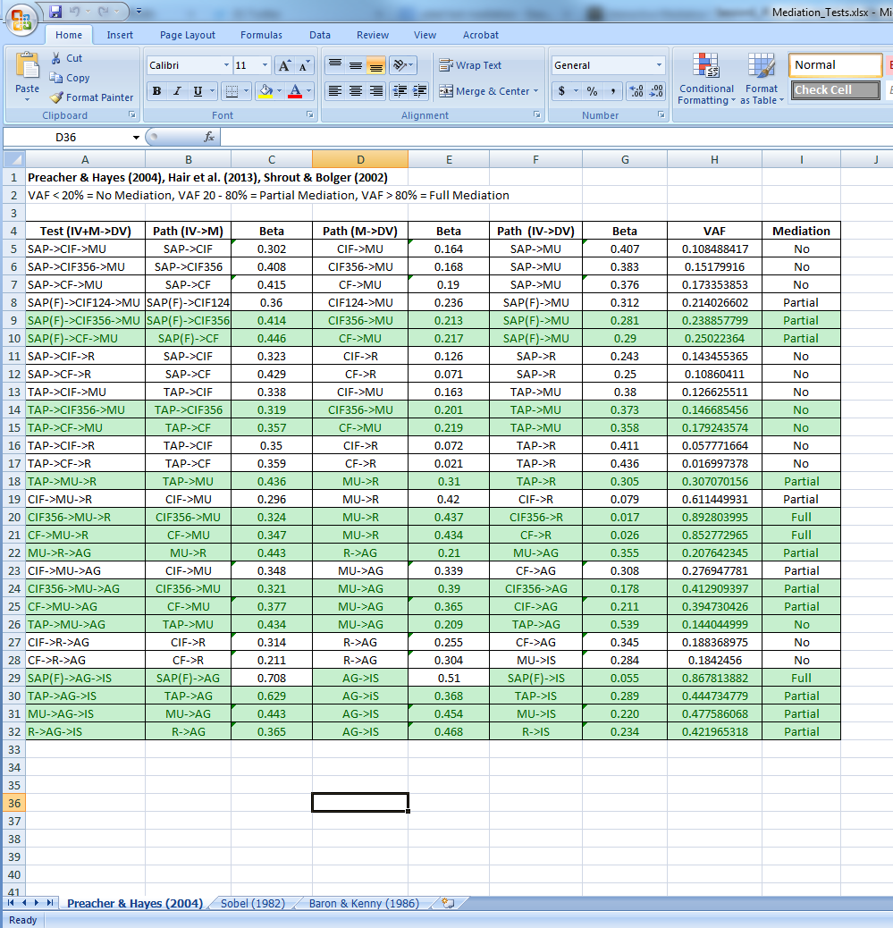
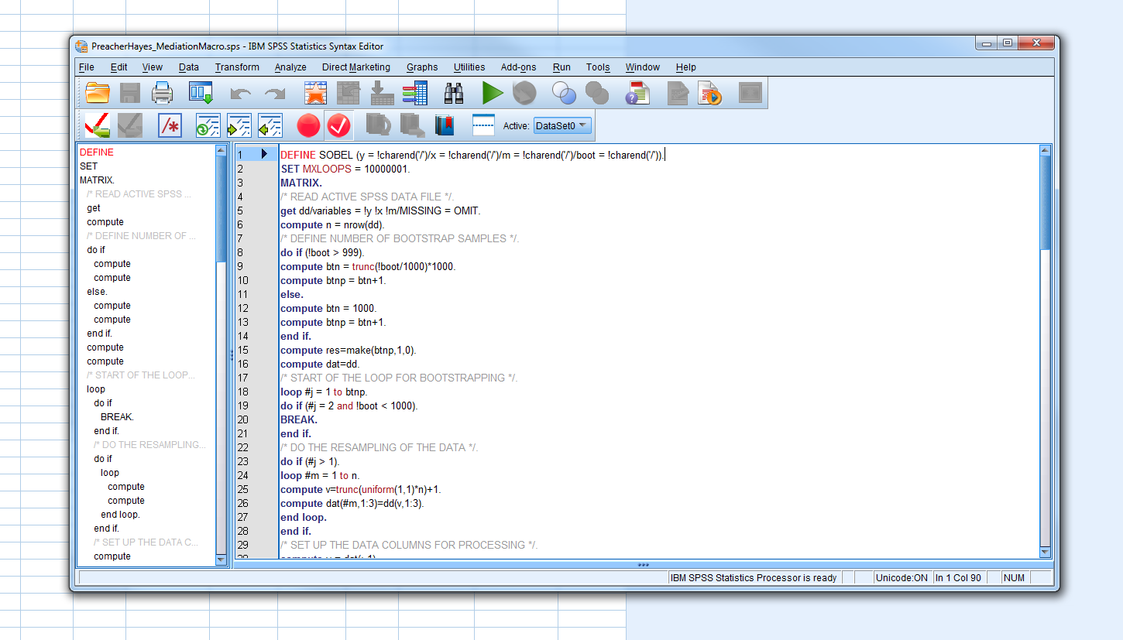
Example

Slide 44
Moderation

Slide 45
The problem with moderation analysis
Moderation usually involves testing two SEMs: one for the sub-sample where the values for the moderator are low; against the sub-sample where the values for the moderator are high.
  Example: PU → ITU in the group where PEOU ratings are low/high.
Problem:
  SEM are more complex and involves more than 1 relationship between 2 variables (or constructs)
  If not, we could run a (M)AN(C)OVA.
  Conceptually, this is tricky theorizing: what should/would change exactly and why?

Slide 46
What could be different between two groups?
Beta weights and/or significance and/or direction
Error terms!
R2 values

Slide 47
Multi-sample path analysis in LISREL
For each moderator, split the data sample into two groups (high/low) and compare the SEMs across the two sub-samples
Once model 1 is identified, the parameter from this model are used to constrain model 2:
  Model2a has factor loadings and error variances constrained to the parameters of model 1.
  Model2b has factor loadings free but error variances constrained to the parameters of model 1.
  Model2c has factor loadings and error variances free.
  Model2d has factor loadings constrained to the parameters of model 1 but error variances free.

Slide 48
Moderation Test
Two tests of Δχ² / Δdf:
  Compare model 2b to 2c: if sig. different, this is caused by error variances: ie measurement error, not moderation effect.
  Compare model 2a to 2b: : if sig. different, this is caused by different factor loadings and path coefficients: ie moderation effect.
  If both tests are sig. different, there is moderation and error variance. In this case, shared error correlations (φ and ψ) must be set to invariant to extract ‘true’ moderation effects.

Slide 49
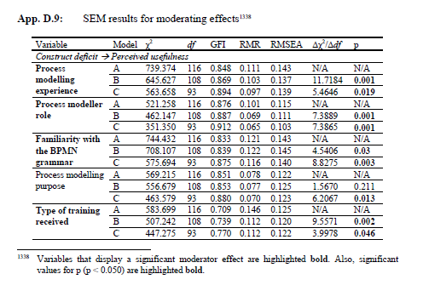
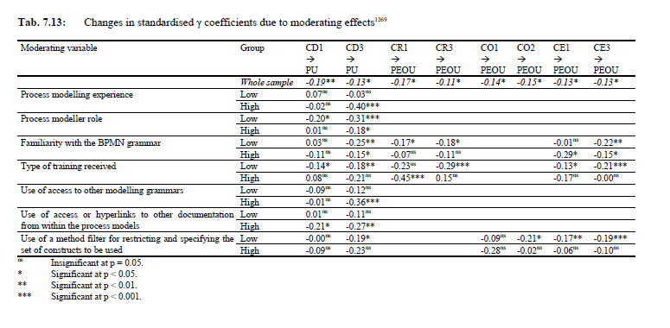
Example

Slide 50
Multi-group analysis in PLS
Multi-group analysis (MGA) in PLS is done by comparing bootstrap parameters across models estimated for two groups.
Essentially tests whether β(1) ≠ β(2).
Much simpler but less accurate than LISREL.

Slide 51
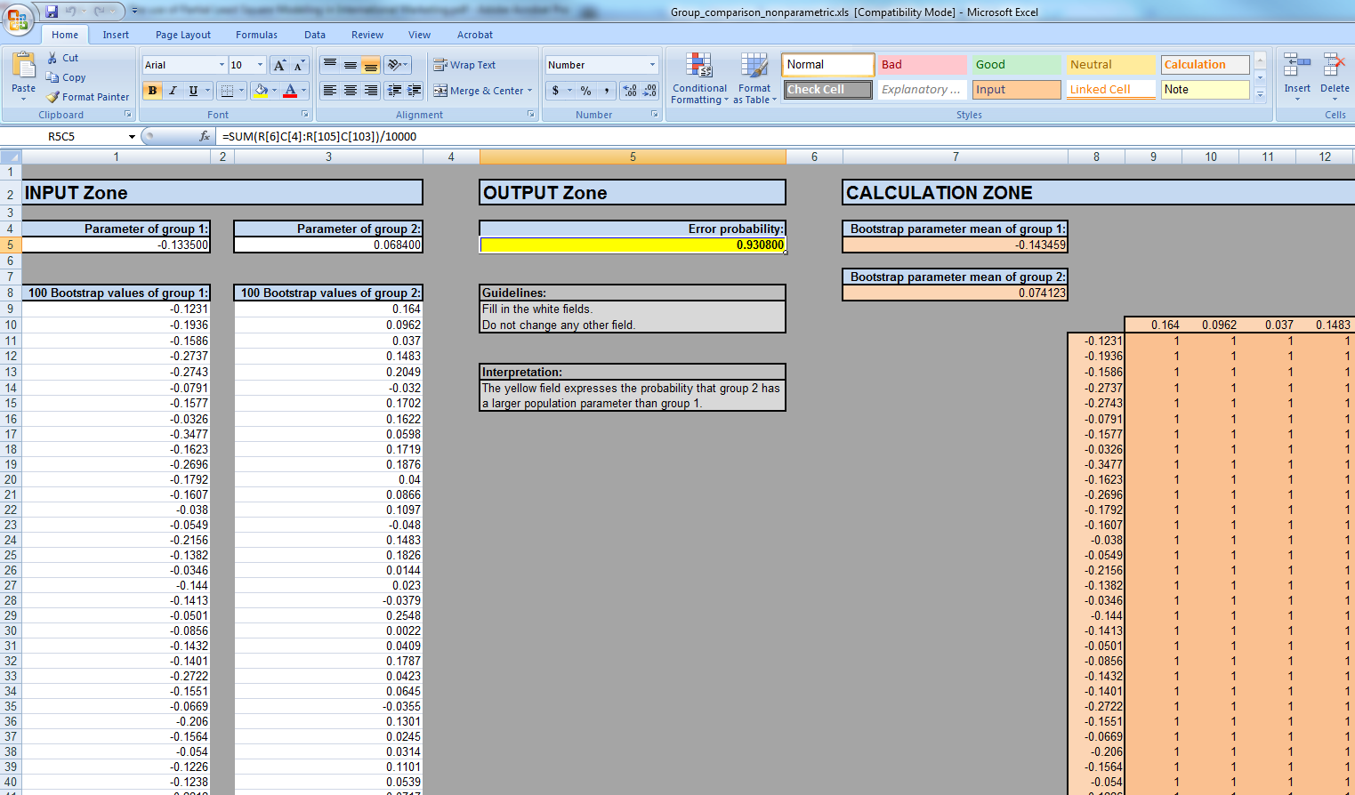

Slide 52
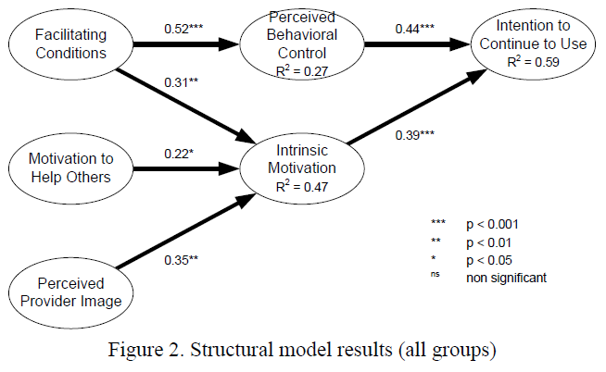
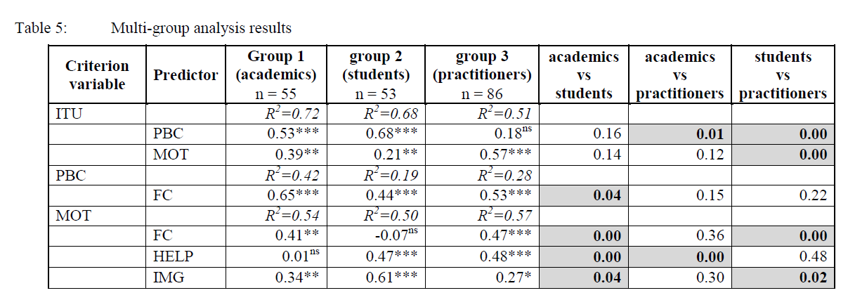
Example
Recker, Jan C. & La Rosa, Marcello (2012) Understanding user differences in open-source workflow management system usage intentions. Information Systems, 37(3), pp. 200-212.

Slide 53
Third approach to moderation analsyis: Interaction terms

Slide 54
Interaction Terms

Slide 55
The corresponding construct table
PU | PEOU | PU x PEOU | ITU
PU1 | PEOU1 | PU1 x PEOU1 | ITU1
PU2 | PEOU2 | PU1 x PEOU2 | ITU2
PU3 | PEOU3 | PU1 x PEOU3 | ITU3
 |  | PU2 x PEOU1
 |  | PU2 x PEOU2
 |  | PU2 x PEOU3
 |  | PU3 x PEOU1
 |  | PU3 x PEOU2
 |  | PU3 x PEOU3

Slide 56
References - basic
Gefen, D., D.W. Straub and M.-C. Boudreau, “Structural Equation Modeling and Regression: Guidelines for Research Practice,” Communications of the Association for Information Systems, 2000, 4:7.
Straub, D.W., M.-C. Boudreau and D. Gefen, “Validation Guidelines for IS Positivist Research,” Communications of the Association for Information Systems, 2004, 13:24, pp. 380-427.
MacKenzie, S.B., P.M. Podsakoff and N.P. Podsakoff, “Construct Measurement and Validation Procedures in MIS and Behavioral Research: Integrating New and Existing Techniques,” MIS Quarterly, 2011, 35:2, pp. 293-334.
Im, K.S. and V. Grover, “The Use of Structural Equation Modeling in IS Research: Review and Recommendations” in Whitman, M.E. and A.B. Woszczynski (eds.) The Use of Structural Equation Modeling in IS Research: Review and Recommendations, Idea Group Hershey, Pennsylvania, 2004, 44-65.
Vinzi, V.E., W.W. Chin, J. Henseler and H. Wang (eds.), Handbook of Partial Least Squares: Concepts, Methods and Applications, Springer, New York, New York, 2010.
Jöreskog, K.G. and D. Sörbom, LISREL 8: User's Reference Guide, Lincolnwood, Illinois: Scientific Software International, 2001.

Slide 57
References – good examples
Moderation/Multi-group analysis: example
  Im, I., Y. Kim and H.-J. Han, “The Effects of Perceived Risk and Technology Type on Users’ Acceptance of Technologies,” Information & Management, 2008, 45:1, pp. 1-9.
  Recker, J. and M. La Rosa, “Understanding User Differences in Open-Source Workflow Management System Usage Intentions,” Information Systems, 2012, 37, pp. 200-212.
Mediation tests: example
  Polites, G.L. and E. Karahanna, “Shackled to the Status Quo: The Inhibiting Effects of Incumbent System Habit, Switching Costs, and Inertia on New System Acceptance ” MIS Quarterly, 2012, 36:1, pp. 21-42.
LISREL with missing data
  Recker, J., M. Rosemann, P. Green and M. Indulska, “Do Ontological Deficiencies in Modeling Grammars Matter?,” MIS Quarterly, 2011, 35:1, pp. 57-79.
LISREL vs PLS
  Goodhue, D.L., W. Lewis and R.L. Thompson, “Statistical Power in Analyzing Interaction Effects: Questioning the Advantage of PLS With Product Indicators,” Information Systems Research, 2007, 18:2, pp. 211-227.
  Ringle, C.M., Sarstedt, M., and Straub, D.W. "Editor's Comments: A Critical Look at the Use of PLS-SEM in MIS Quarterly," MIS Quarterly (36:1) 2012, pp iii-xiv.

Slide 58
References – further reading
Straub, D.W., M.-C. Boudreau and D. Gefen, “Validation Guidelines for IS Positivist Research,” Communications of the Association for Information Systems, 2004, 13:24, pp. 380-427.
MacKenzie, S.B., P.M. Podsakoff and N.P. Podsakoff, “Construct Measurement and Validation Procedures in MIS and Behavioral Research: Integrating New and Existing Techniques,” MIS Quarterly, 2011, 35:2, pp. 293-334.
Wetzels, M., G. Odekerken-Schröder and C. Van Oppen, “Using PLS Path Modeling for Assessing Hierarchical Construct Models: Guidelines and Empirical Illustration,” MIS Quarterly, 2009, 33:1, pp. 177-195.
Ringle, C.M., M. Sarstedt and D.W. Straub, “Editor's Comments: A Critical Look at the Use of PLS-SEM in MIS Quarterly,” MIS Quarterly, 2012, 36:1, pp. iii-xiv.
Evermann, J. and M. Tate, “Fitting Covariance Models for Theory Generation,” Journal of the Association for Information Systems, 2011, 12:9, pp. 632-661.
Evermann, J. and M. Tate, “Bayesian Structural Equation Models for Cumulative Theory Building in Information Systems―A Brief Tutorial Using BUGS and R,” Communications of the Association for Information Systems, 2014, 34:77, pp. 1481-1514.

Slide 59
Websites I use
Online Statistics Textbook
  http://www.statsoft.com/Textbook
Statistical tables calculator
  http://vassarstats.net/tabs.html
Distribution tables for χ, t, F
  http://www.medcalc.org/manual/chi-square-table.php
  http://vassarstats.net/textbook/apx_d.html
  http://www.psychstat.missouristate.edu/introbook/tdist.htm
Interactive mediation tests
  http://quantpsy.org/sobel/sobel.htm

Slide 60

Exercise – contact me

Slide 61
End of Part 4
© Copyright 2017 W. Mertens, A. Pugliese & J. Recker. All Rights Reserved.

